Slide 1
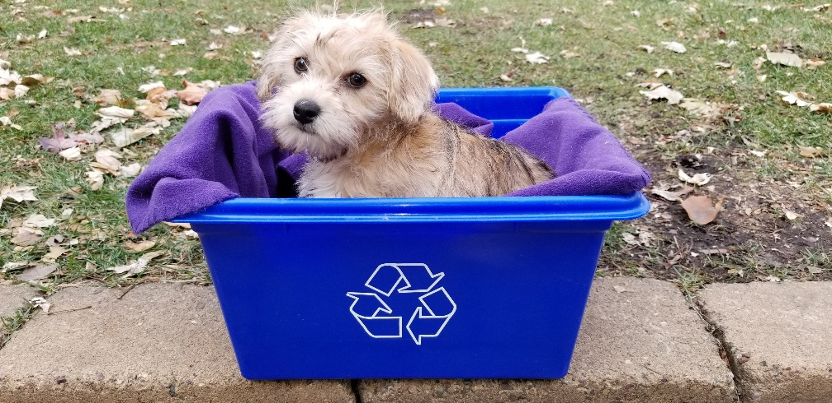
Richfield Organized Collection Process 1/24/24

Slide 2
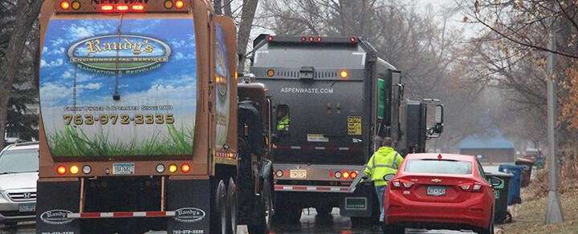
Overview of Richfield’s program
Declared intent to organize Nov 2020, contract signed in June 2021, service started Oct 4, 2021
Did research before that; originally wanted to just do recycling and organics
Trash, recycle, organics, yard waste, bulkies
Currently ~9,900 RDUs (single-family and duplexes, some HOA opt-in)
Hauler bills resident (tenant or owner)

Slide 3
Public sentiment before
More favorable than not
Economic, environmental, equity, safety reasons
Able to explain city rationale thoroughly which helped assuage resident concerns about service/not being able to connect with staff and get issues fixed
Pricing analysis
Concerns about switching haulers, not being able to negotiate rates
Frequently updated website, FAQ, etc.

Slide 4
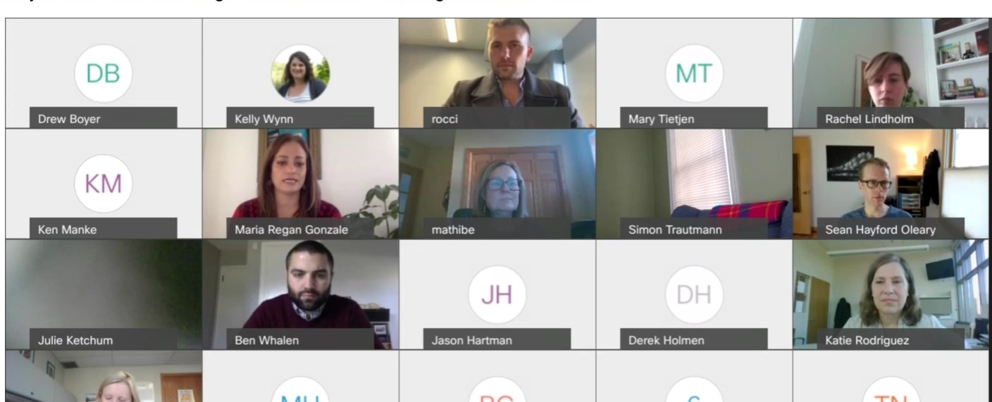
What went well – negotiations
Term sheet, list of priorities, wants/needs
Concurrent listening and learning sessions with residents
Aligning with Bloomington’s contract (hauler familiarity too)
Council and staff strength/capacity (no consultant)

Slide 5
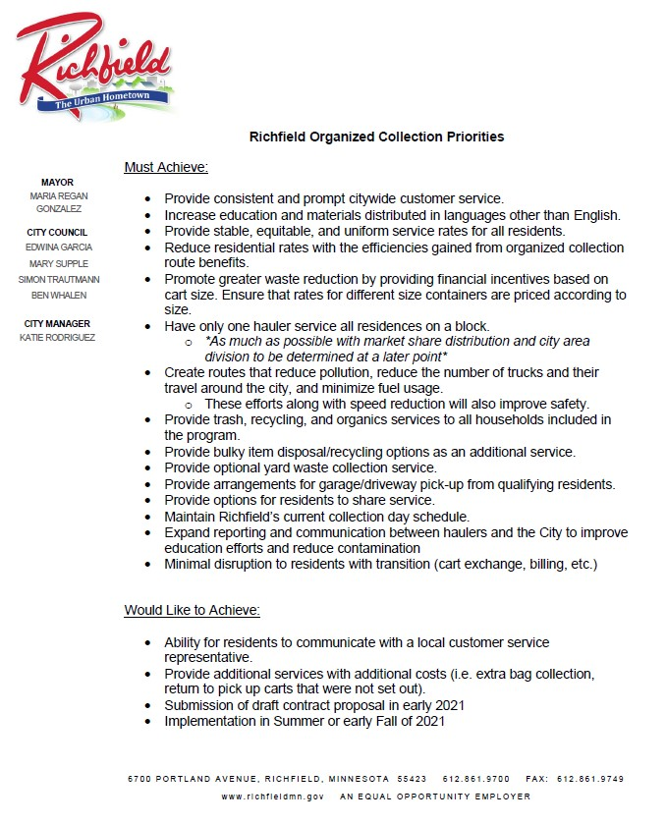

Slide 6
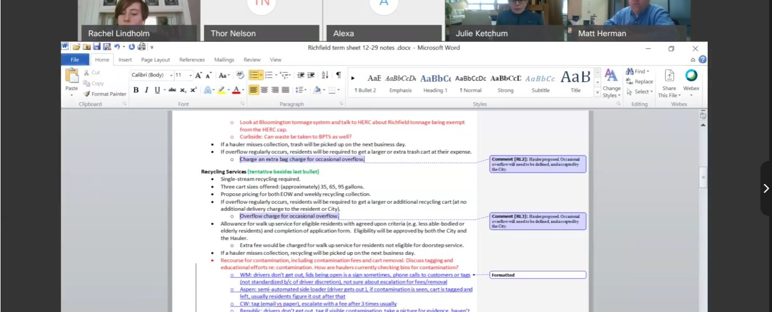
Areas to focus on - negotiations
Aligning expectations with haulers and market share
Making sure all parties are negotiating based on clear, correct information
Pricing analysis – residents and other cities

Slide 7
What went well - implementation
Overall haulers were able to execute a quick roll-out which benefitted most residents
Several communications (letters, postcards) ahead of the switch
Intense staff “groundwork” – phone calls, emails, individual points of communication
Ability to pivot as needed for situations like double YW cart delivery, cart sizes, etc.
Staging areas
Organics delivery on the second week
Fall roll-out (not winter)
City specific email addresses set up by haulers

Slide 8
Areas to improve - implementation
Might have planned a slightly longer roll-out process
More explicitly communicated to residents that they’d be receiving the cart sizes listed on their account (which turned out to not always be what they had on site)
Even asking residents what size they want is tricky/switches will need to be made either way
Potentially deliver organics at the same time
Phone access between residents and haulers

Slide 9
Public sentiment after
Overall, it seems favorable still
New services, consistent pricing for everyone, resident protection, city staff involvement
Most comments otherwise are when the annual escalator is billed, organics questions, or if service issues escalate
Residents are able to quickly get answers from staff and resolution

Slide 10
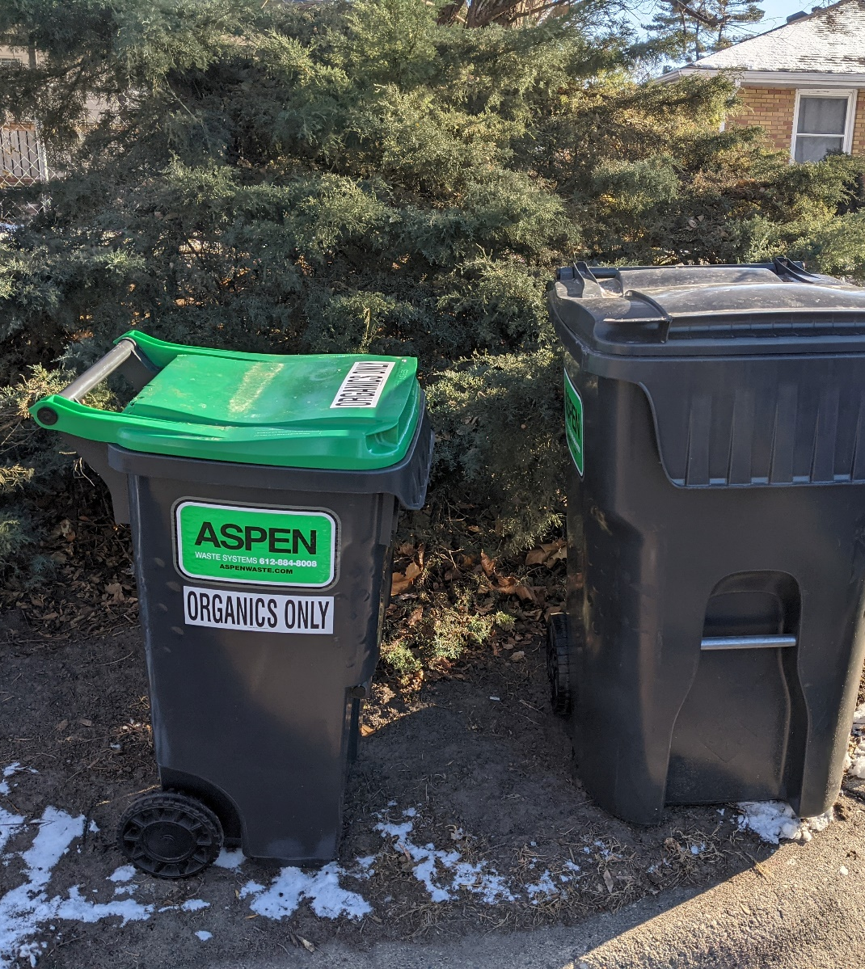
Lessons learned
We did it during early-ish Covid, so everything was virtual
Public engagement – highlight things like service from city, pricing, service options (EOW trash)
People really wanted reliable service (then pricing)
Resident choice was raised but quieted down
Making amendments – easy to get consensus on changing small things (Christmas tree schedule)
Pricing comparison between resident bills, other cities’ rates
Cart size breakdown – could be helpful to have some level of understanding as you go through negotiations

